Slide 1
VXT2 Evaluation
Speaker Title / Company Name
YYYY.MM.DD
Speaker Name

Slide 2
PA_TOIout Test
PA_TOIout Org:
DAC_Nbits=14
GainImblance=0.002
IQ offset=0.0044
Phase Noise =[100, -87.133, 1000, -96.072, 1e5, -108.607];
PA_TOIout=30
PA_TOIout Change 10dB:
DAC_Nbits=14
GainImblance=0.002
IQ offset=0.0044
Phase Noise =[100, -87.133, 1000, -96.072, 1e5, -108.607];
PA_TOIout=20
PA_TOIout Change 15dB:
DAC_Nbits=14
GainImblance=0.002
IQ offset=0.0044
Phase Noise =[100, -87.133, 1000, -96.072, 1e5, -108.607];
PA_TOIout=15

Slide 3
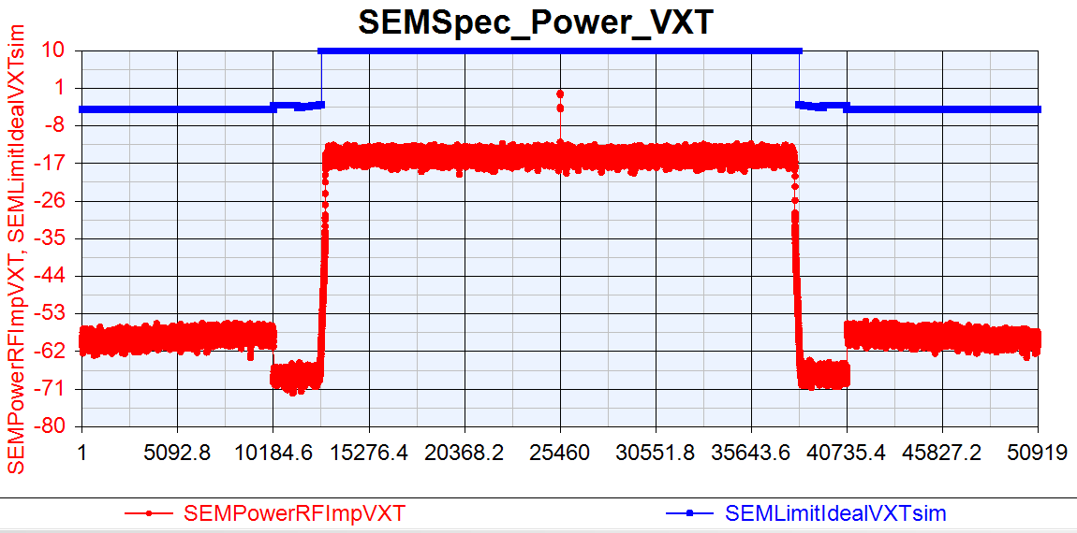
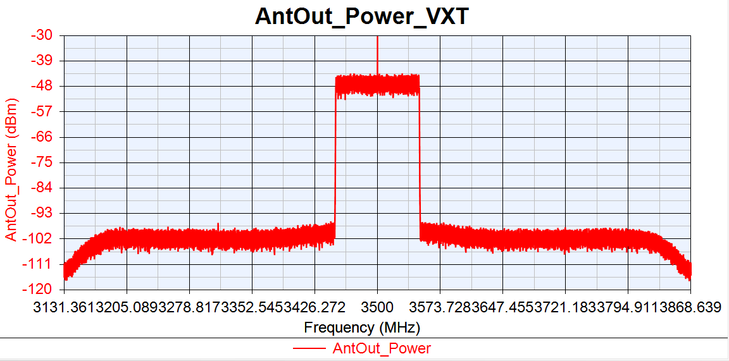
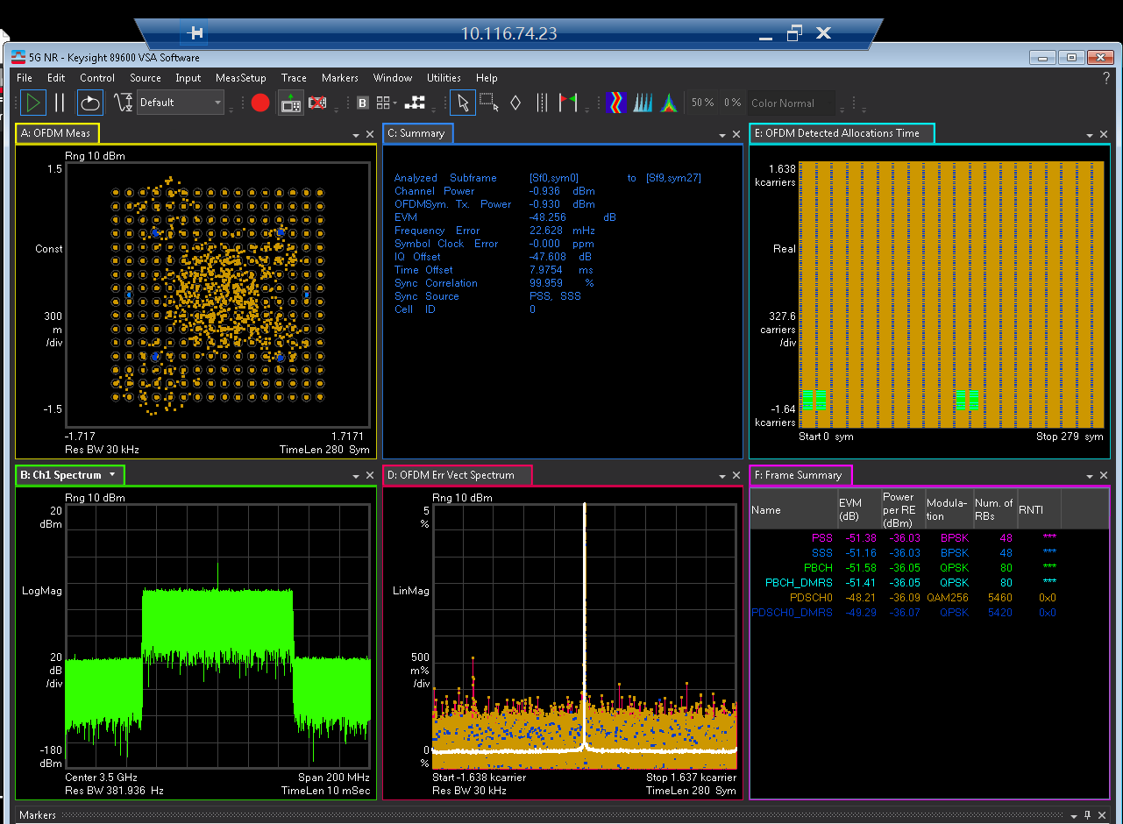
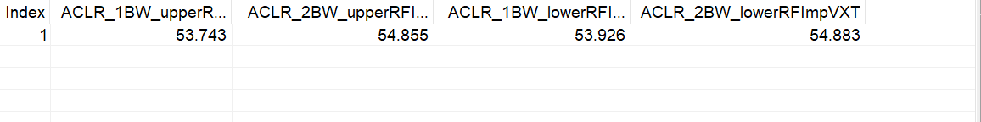
VXT_TOI=30

Slide 4
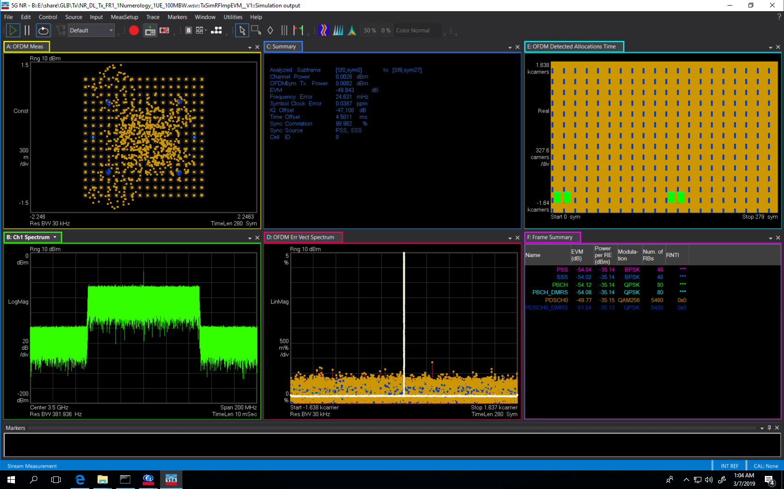

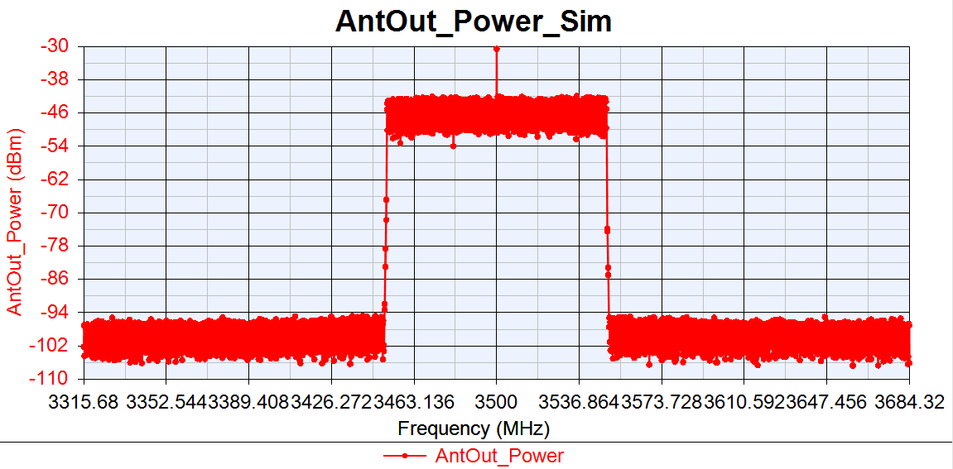
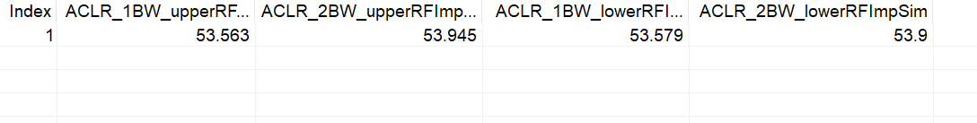
Sim_TOI=30

Slide 5
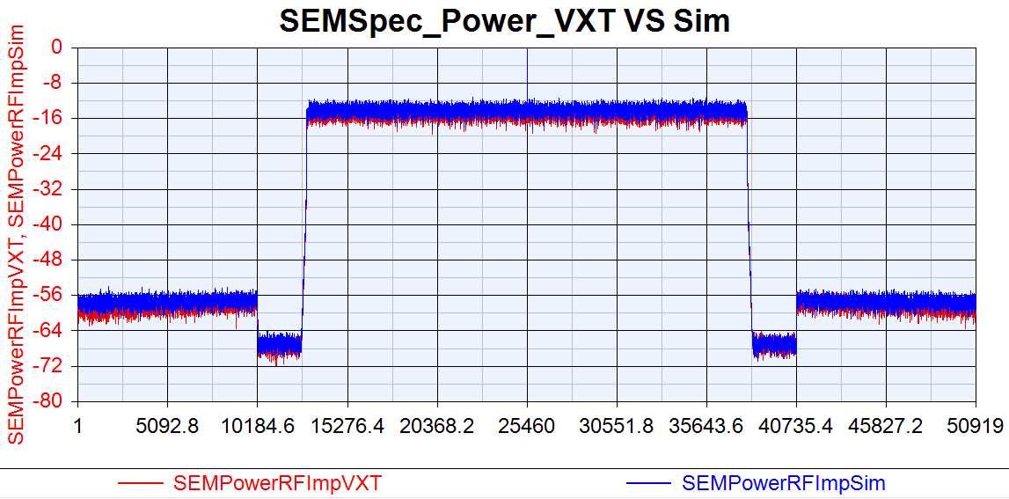

Slide 6
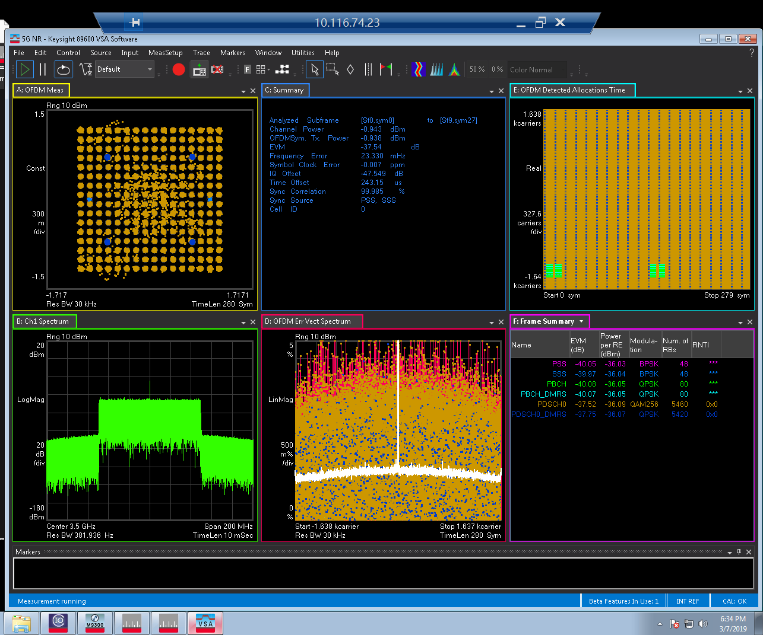
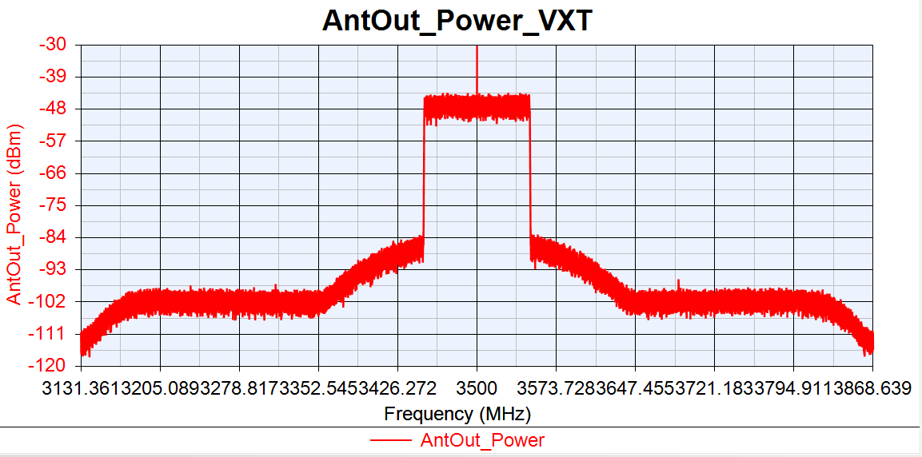
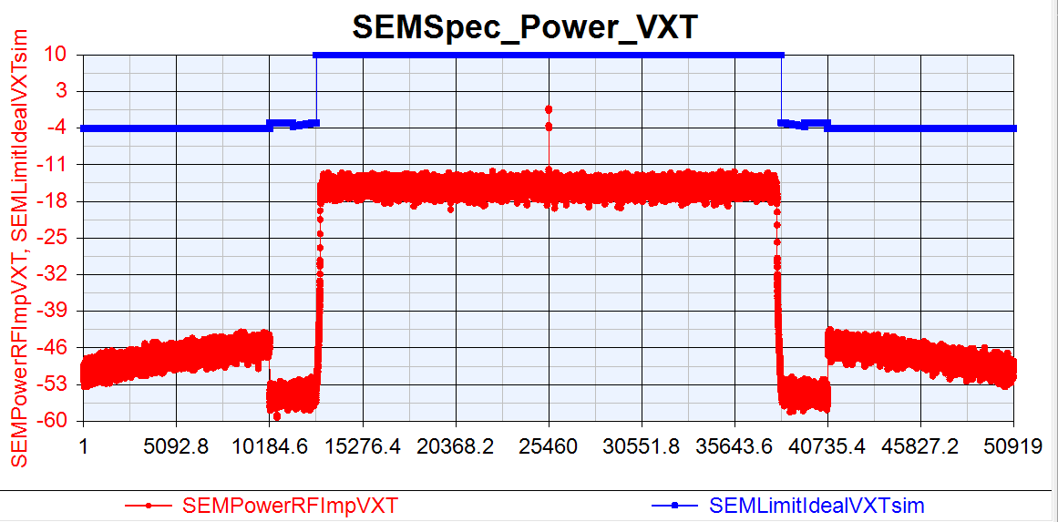
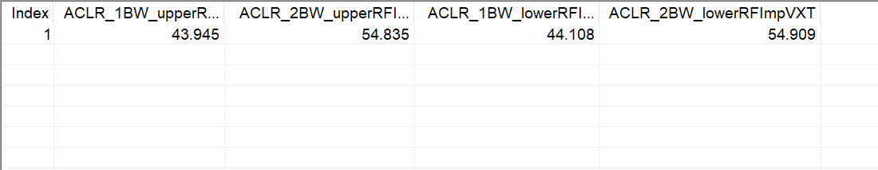
VXT_TOI=20

Slide 7
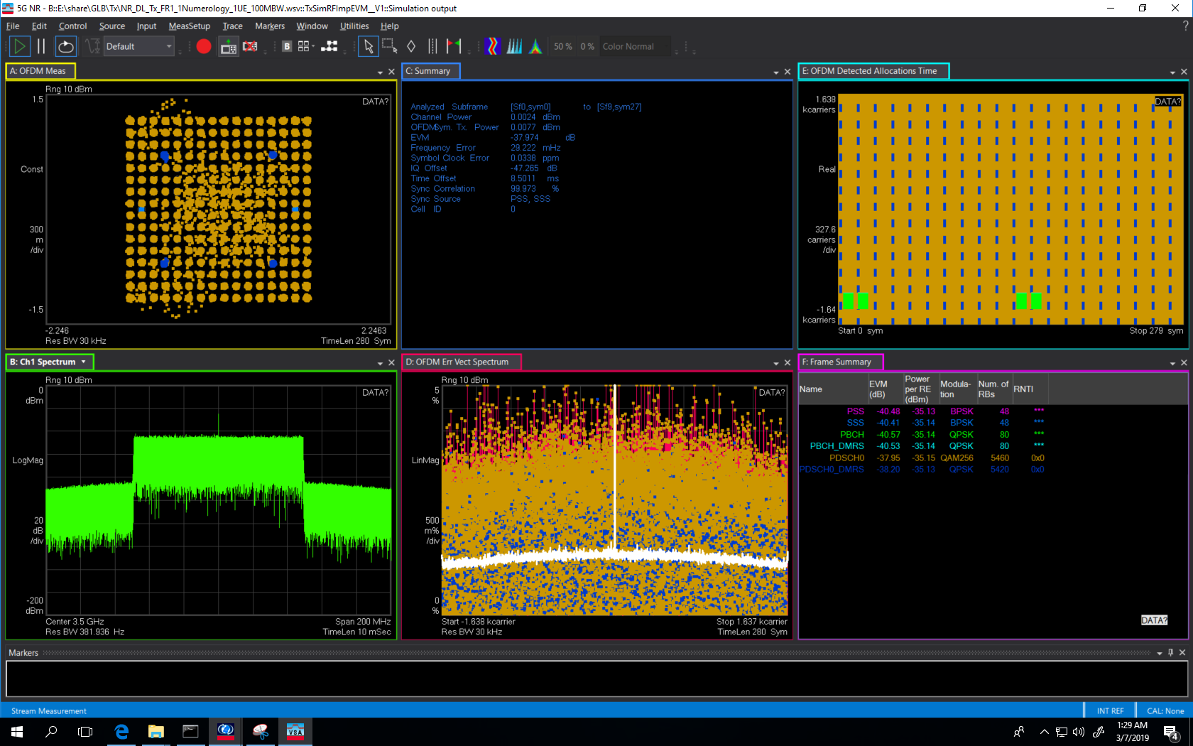
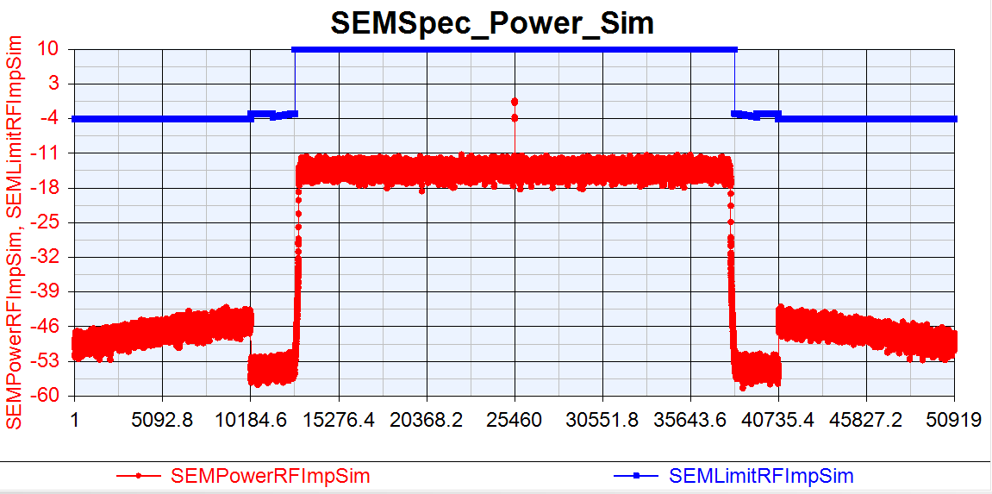
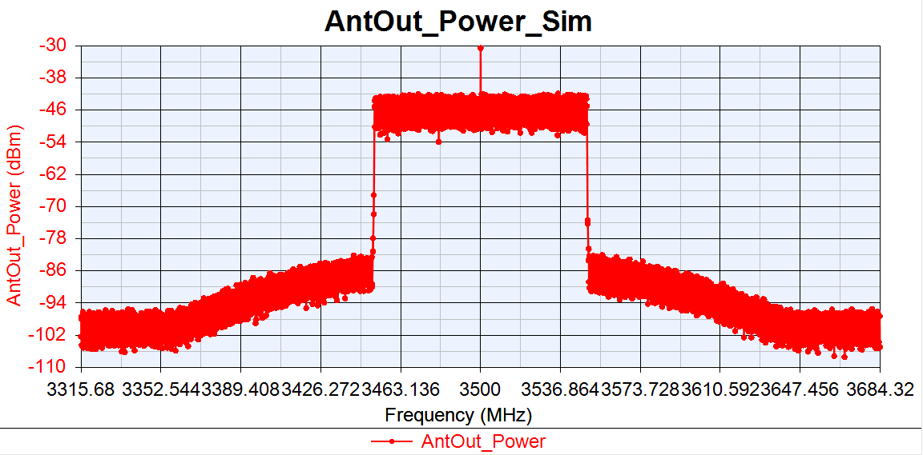
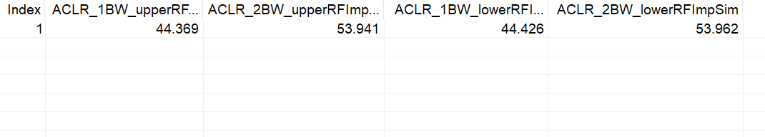
Sim_TOI=20

Slide 8
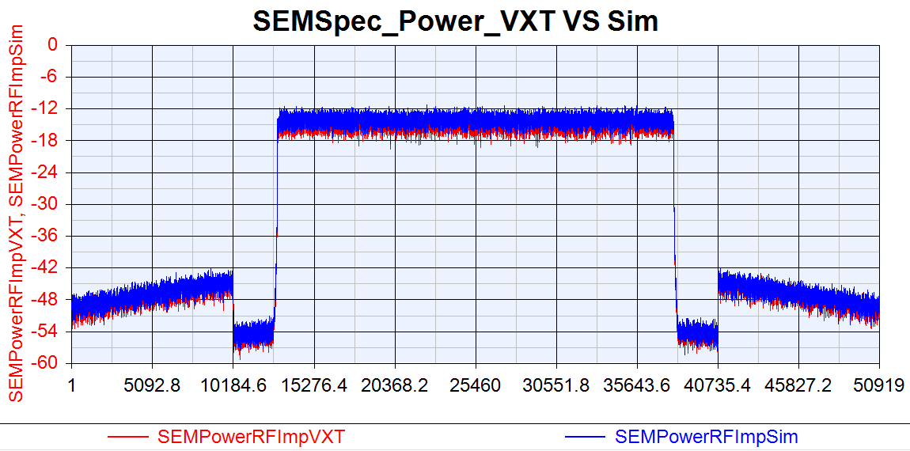

Slide 9
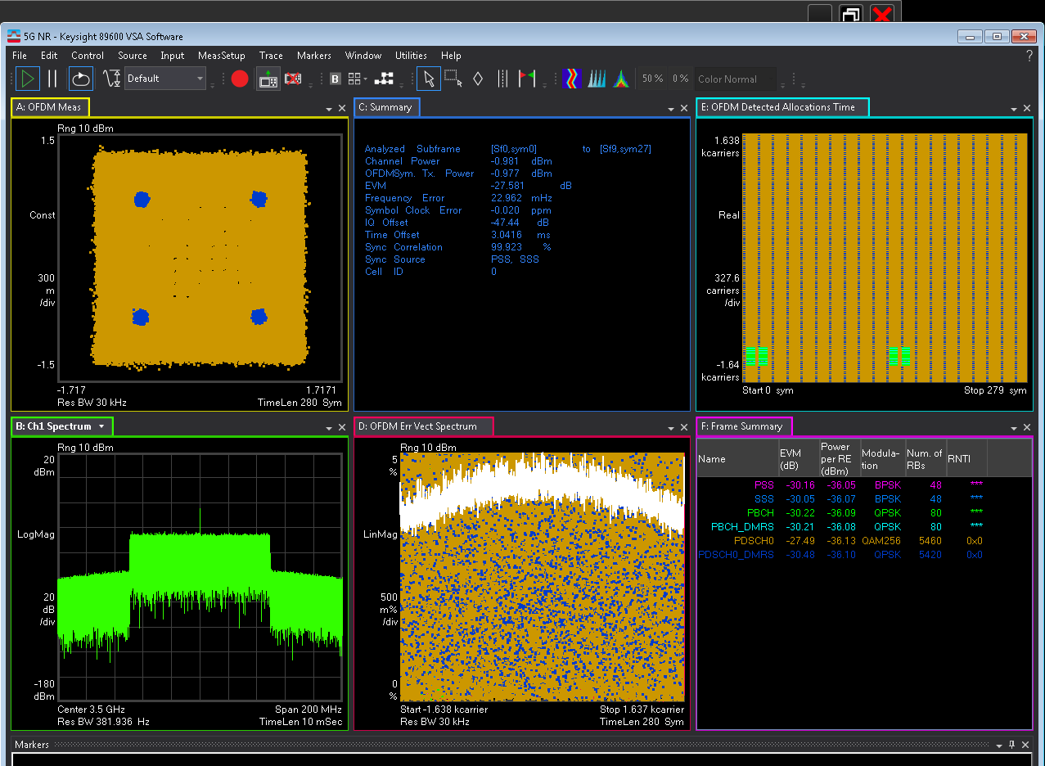
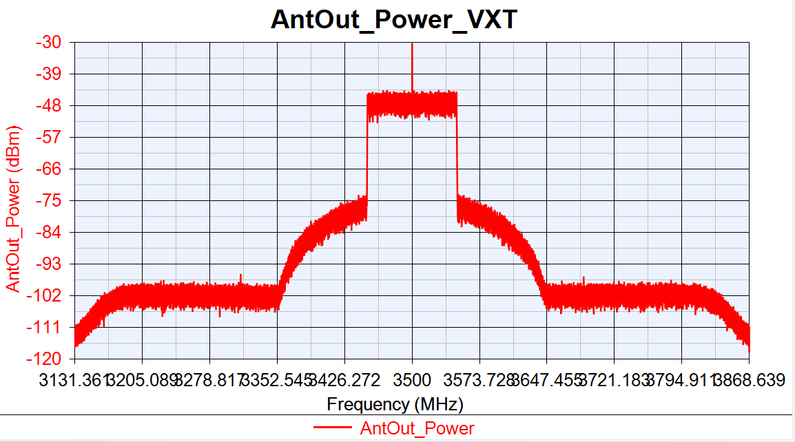
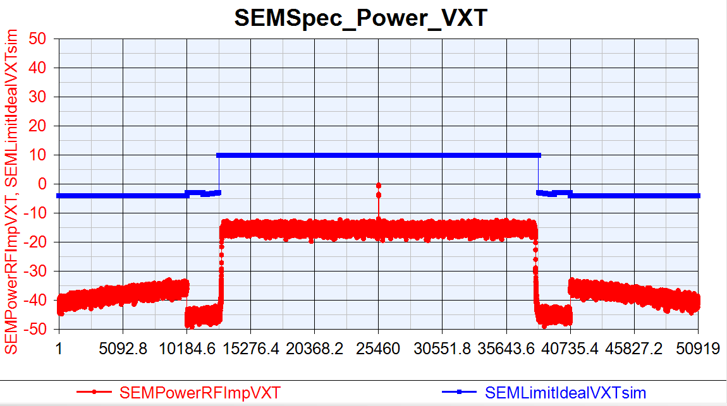
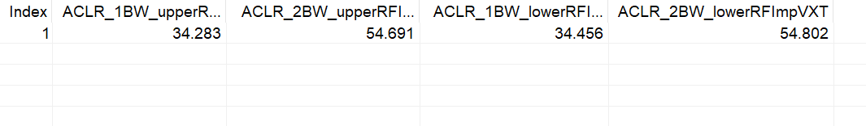
VXT_TOI=15

Slide 10
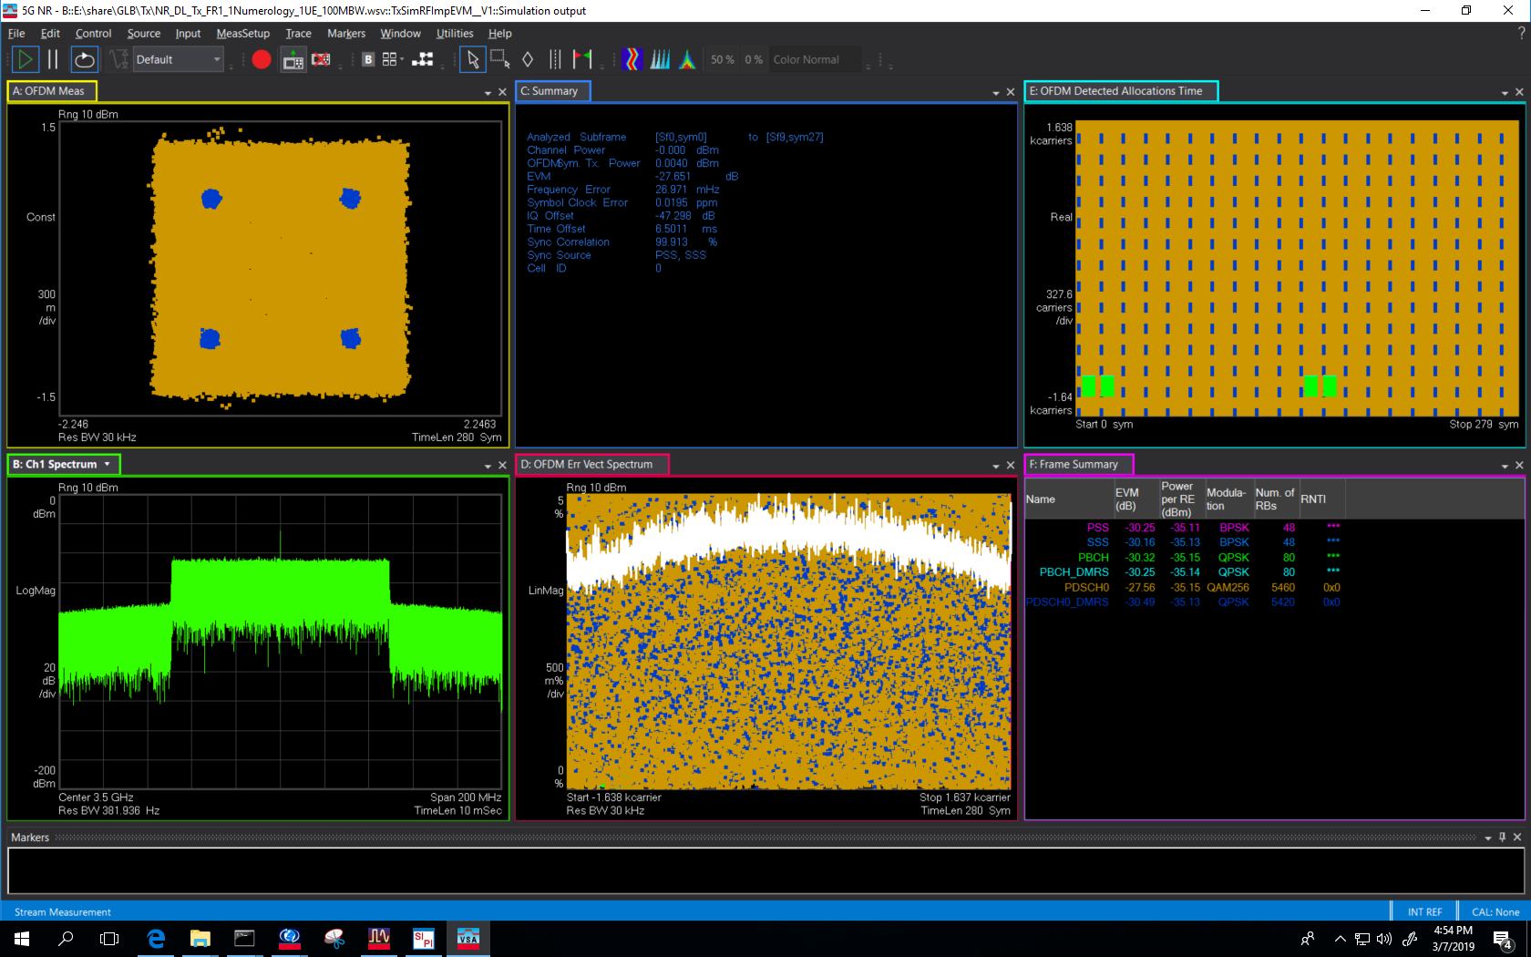
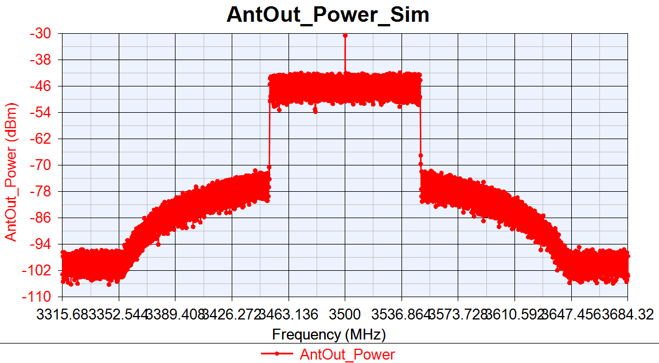
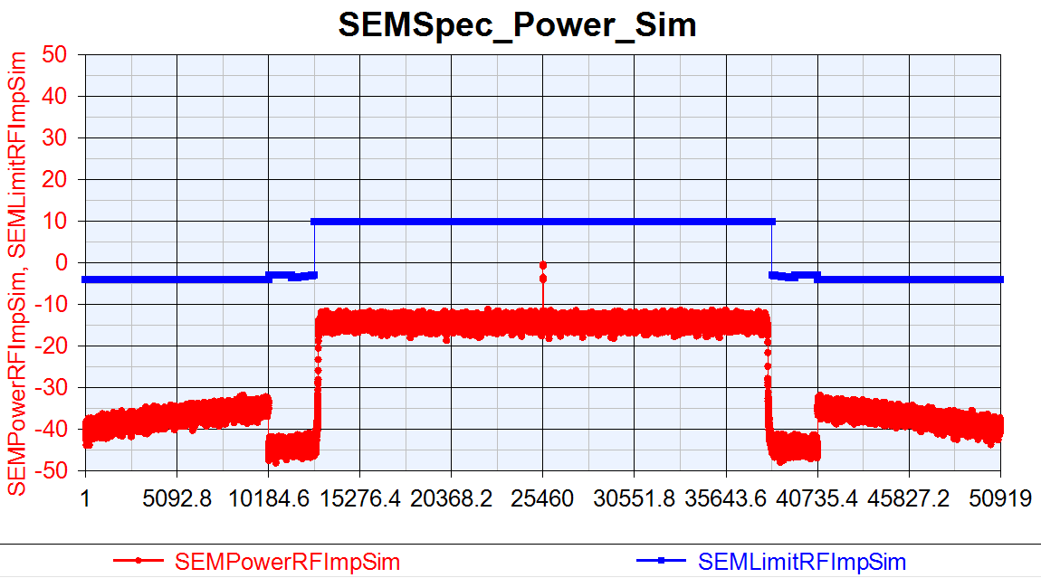
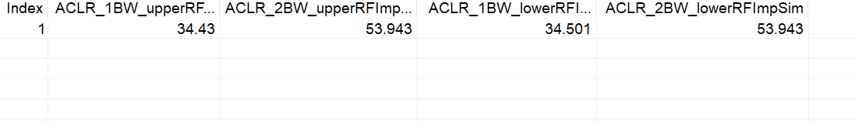
Sim_TOI=15

Slide 11
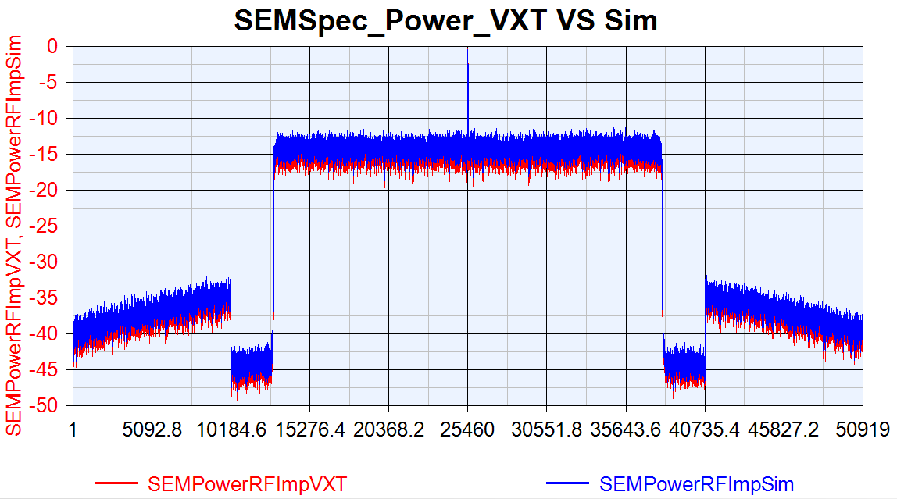

Slide 12
Phase Noise Test
Phase Noise Change 10dB:
DAC_Nbits=14
GainImblance=0.002
IQ offset=0.0044
Phase Noise =[100, -87.133, 1000, -96.072, 1e5, -108.607];
PA_TOIout=20
Phase Noise Change 15dB:
DAC_Nbits=14
GainImblance=0.002
IQ offset=0.0044
Phase Noise =[100, -82.133, 1000, -91.072, 1e5, -103.607];
PA_TOIout=20

Slide 13
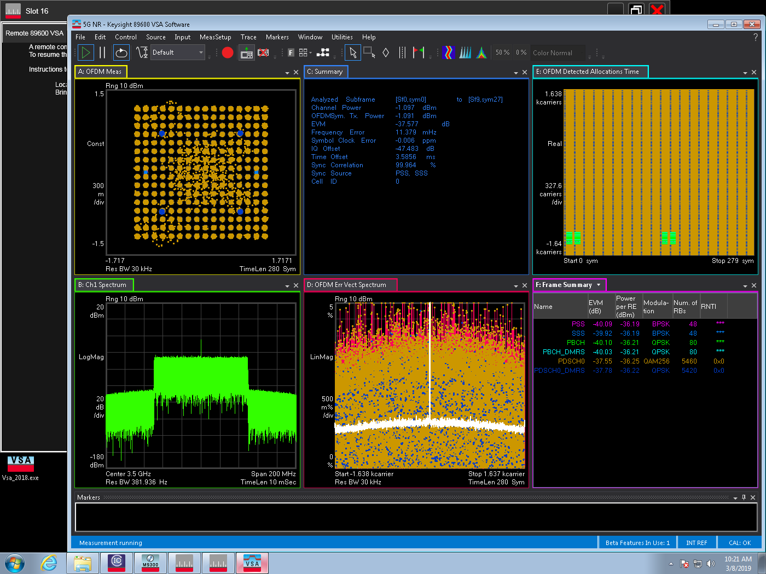
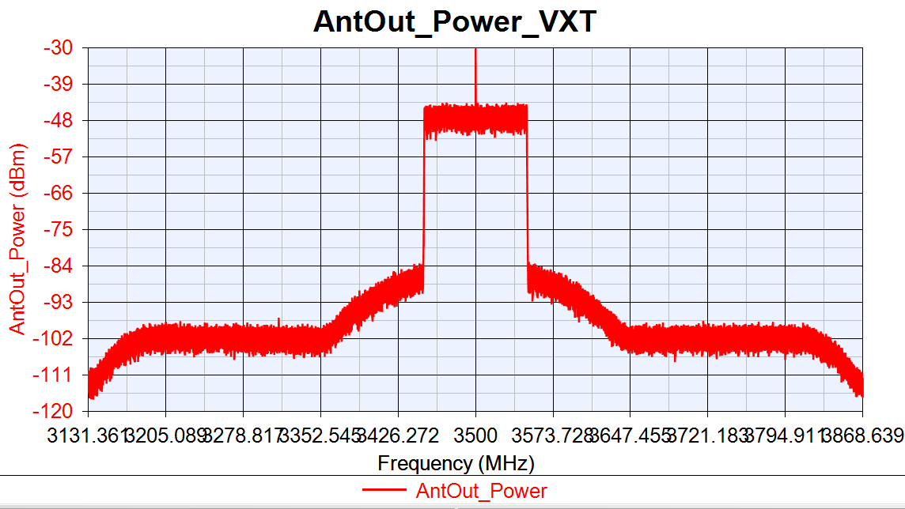
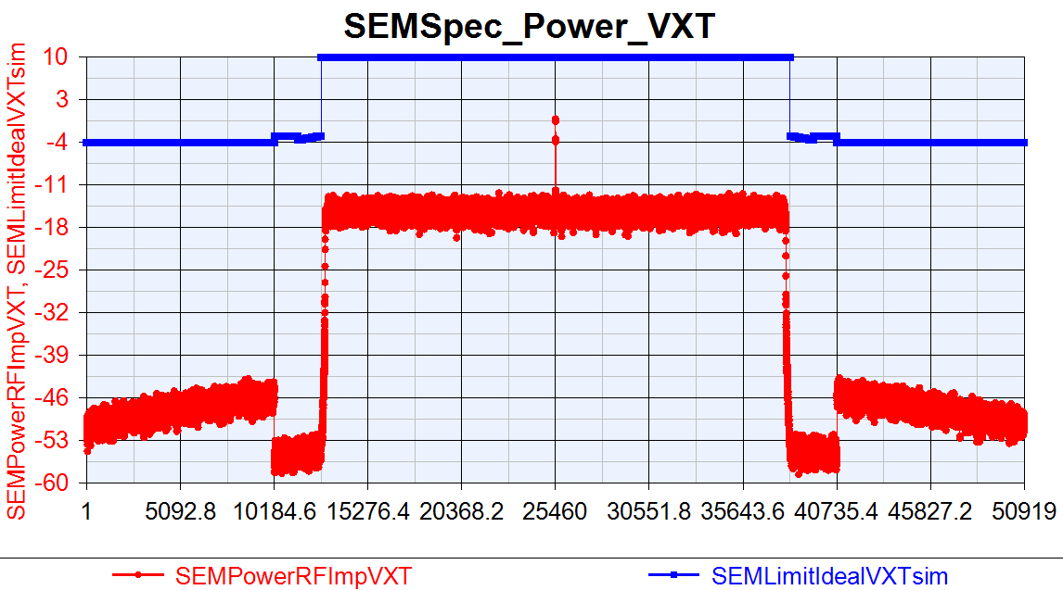
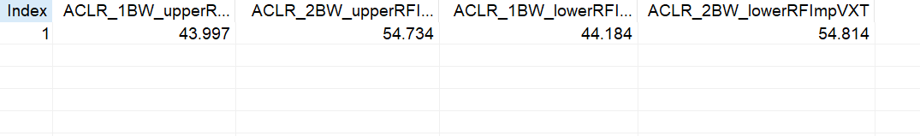
VXT_PhaseNoise -10dB

Slide 14

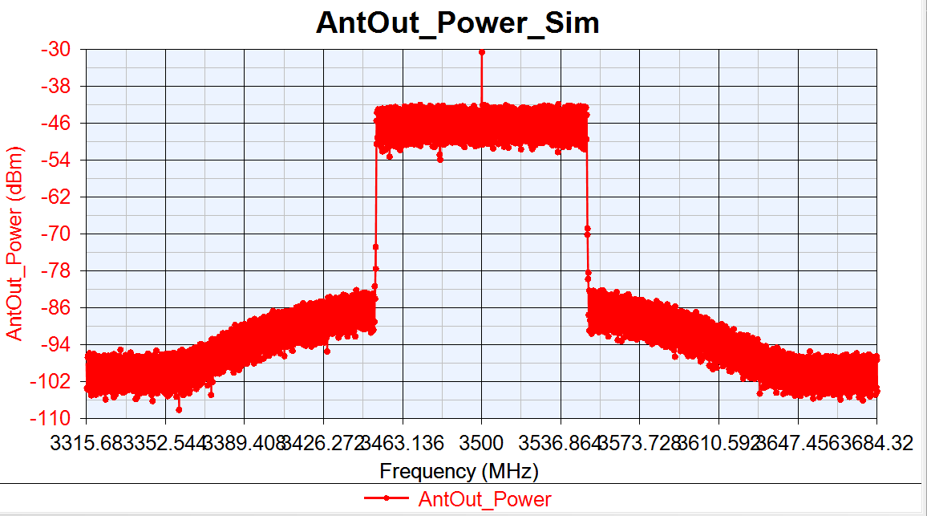

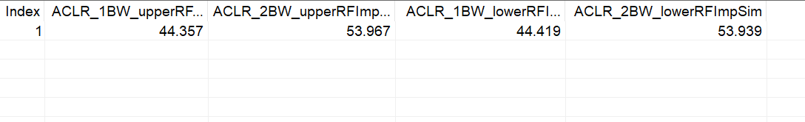
Sim_PhaseNoise -10dB

Slide 15
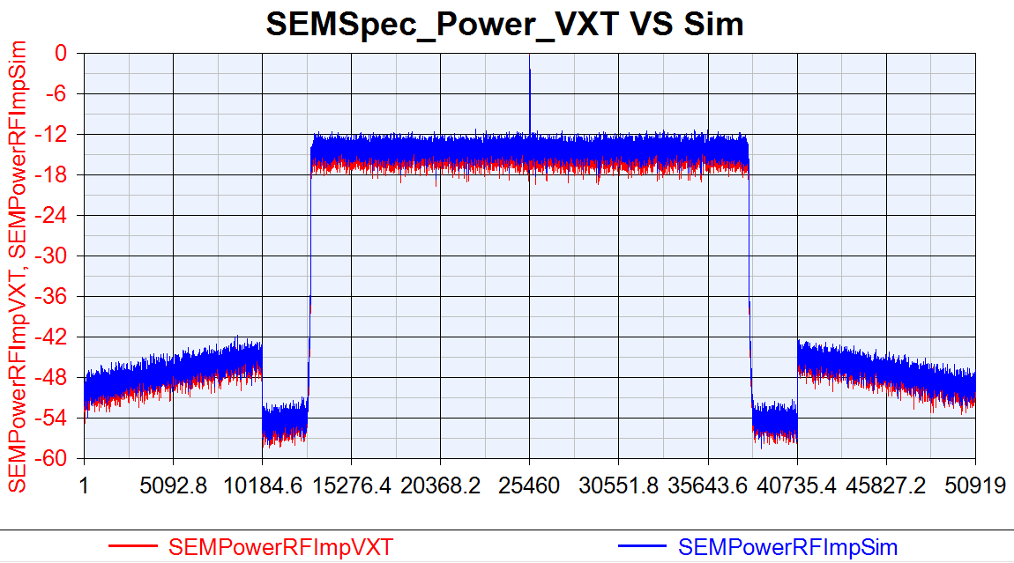

Slide 16
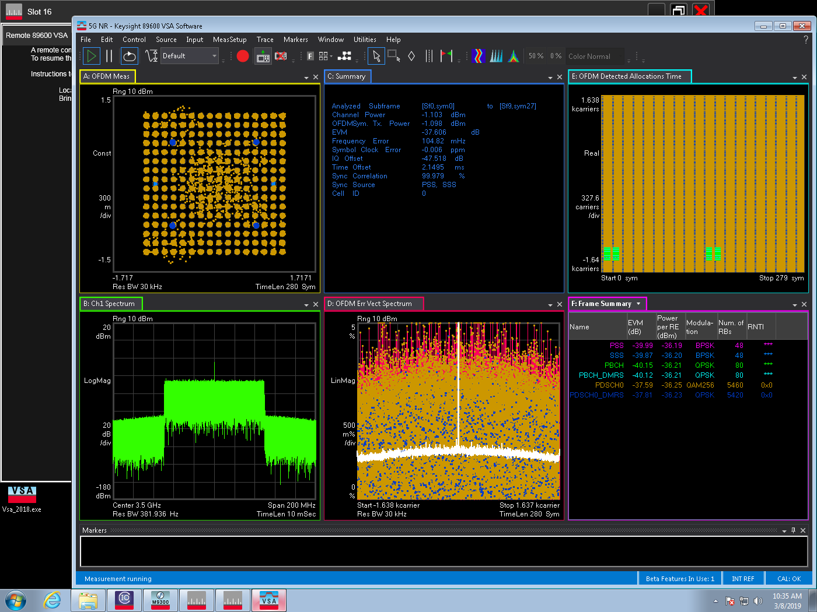
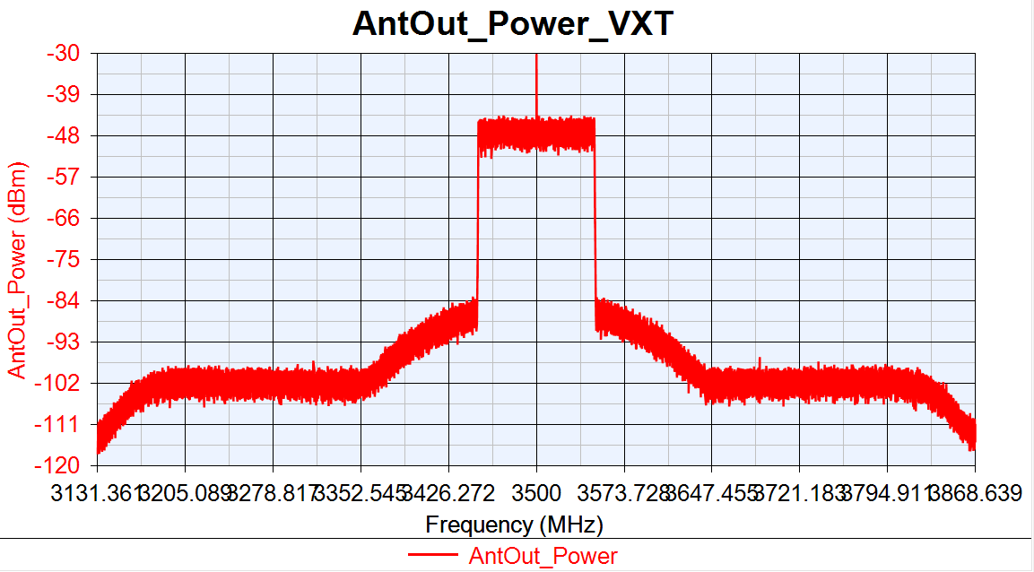

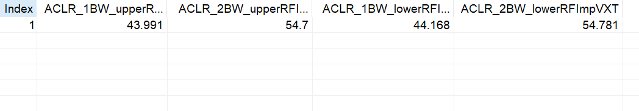
VXT_PhaseNoise -15dB

Slide 17

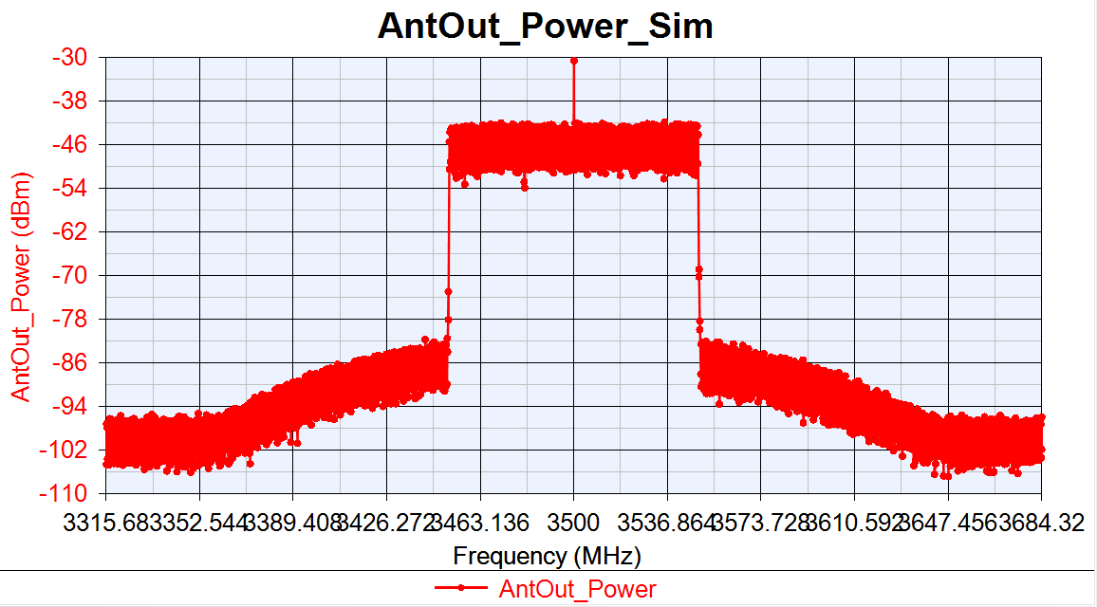

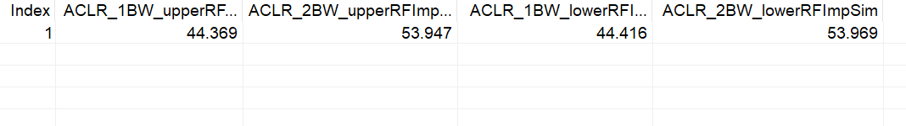
Sim_PhaseNoise -15dB

Slide 18


Slide 19
DAC_Nbits Test
DAC_Nbits Org :
DAC_Nbits=14
GainImblance=0.002
IQ offset=0.0044
Phase Noise =[100, -97.133, 1000, -106.072, 1e5, -118.607]; PA_TOIout=20
DAC_Nbits Change 12:
DAC_Nbits=12
GainImblance=0.002
IQ offset=0.0044
Phase Noise =[100, -97.133, 1000, -106.072, 1e5, -118.607]; PA_TOIout=20
DAC_Nbits Change 10:
DAC_Nbits=10
GainImblance=0.002
IQ offset=0.0044
Phase Noise= [100, -97.133, 1000, -106.072, 1e5, -118.607]; PA_TOIout=20

Slide 20

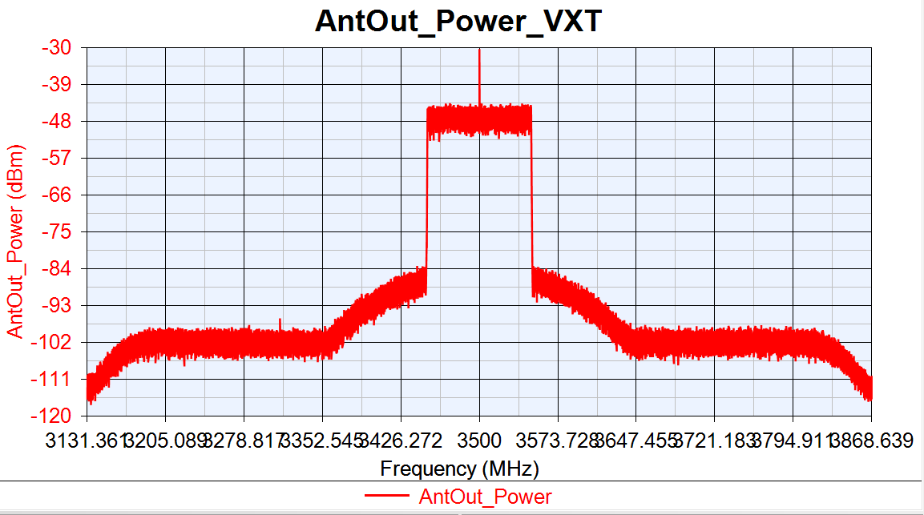

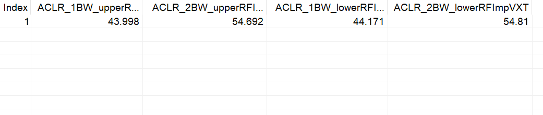
Test DAC_Nbits=14

Slide 21



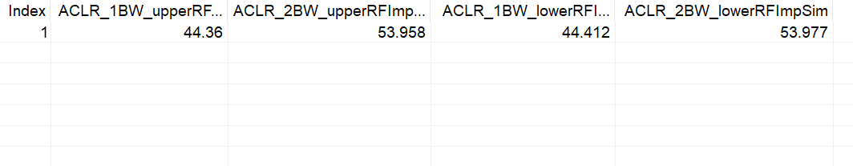
Sim DAC_Nbits=14

Slide 22


Slide 23



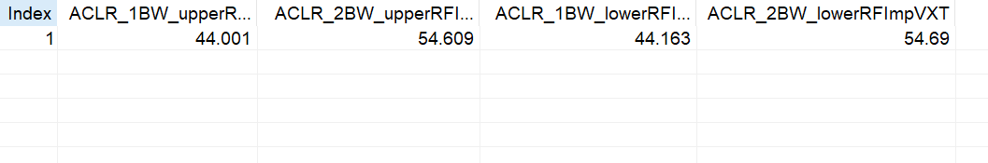
Test DAC_Nbits=12

Slide 24


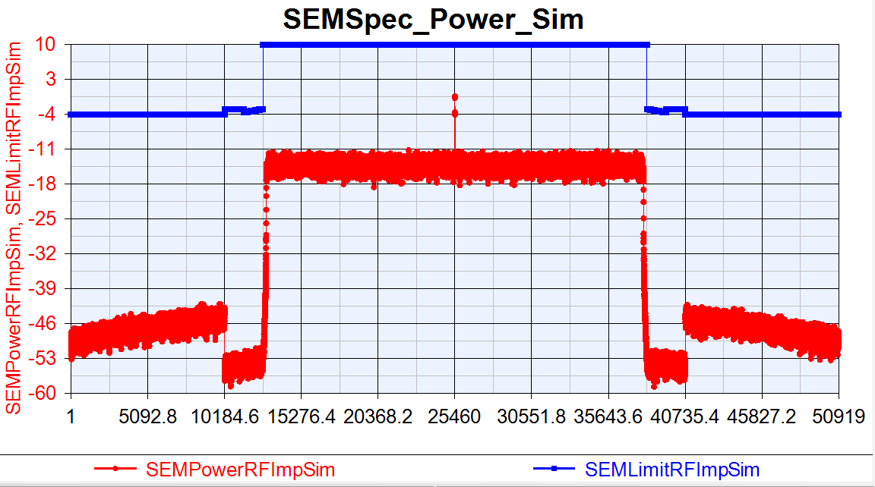
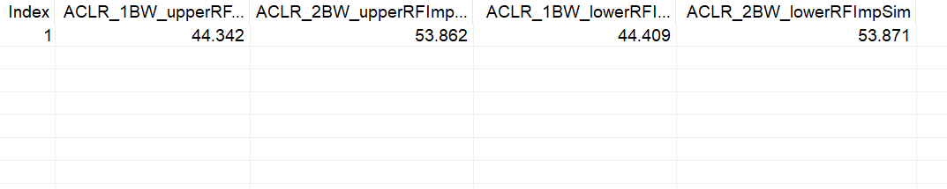
Sim DAC_Nbits=12

Slide 25


Slide 26
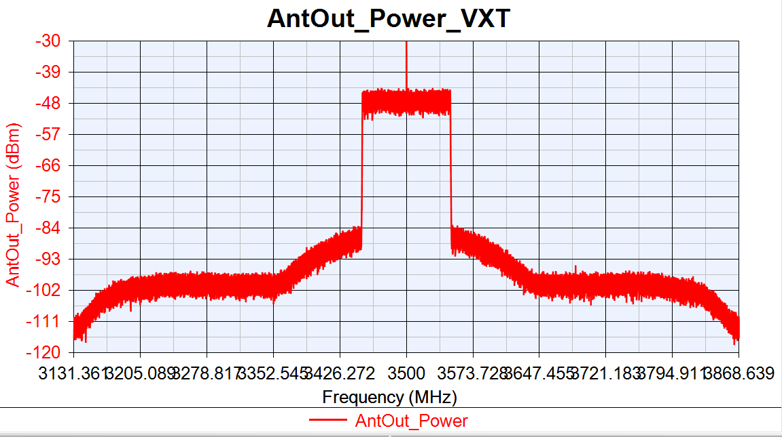

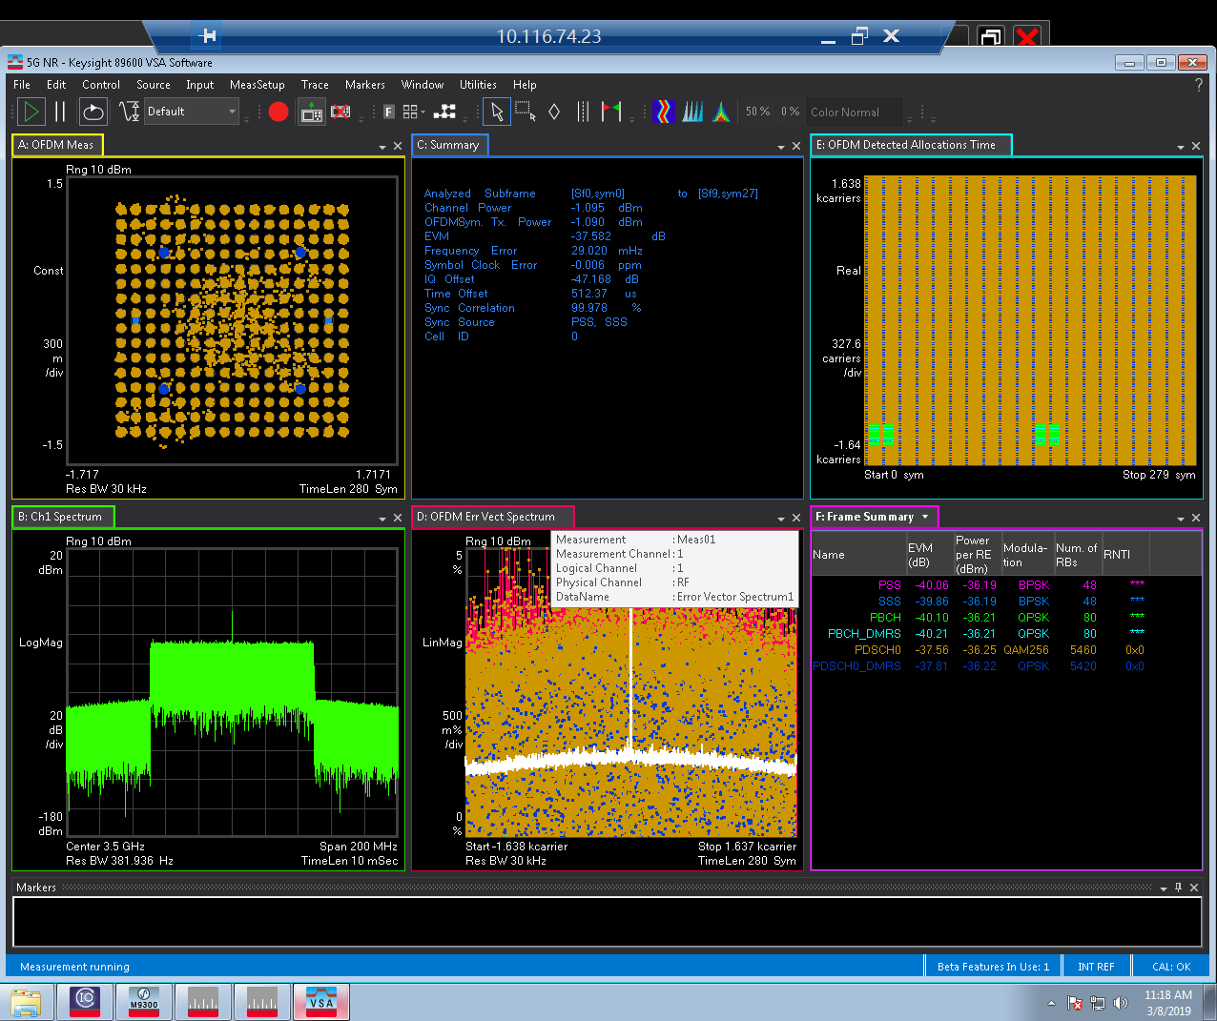
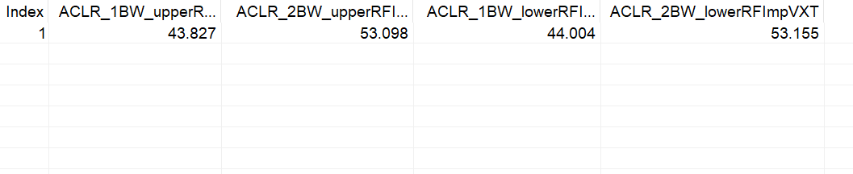
VXT_DAC_Nbits=10

Slide 27

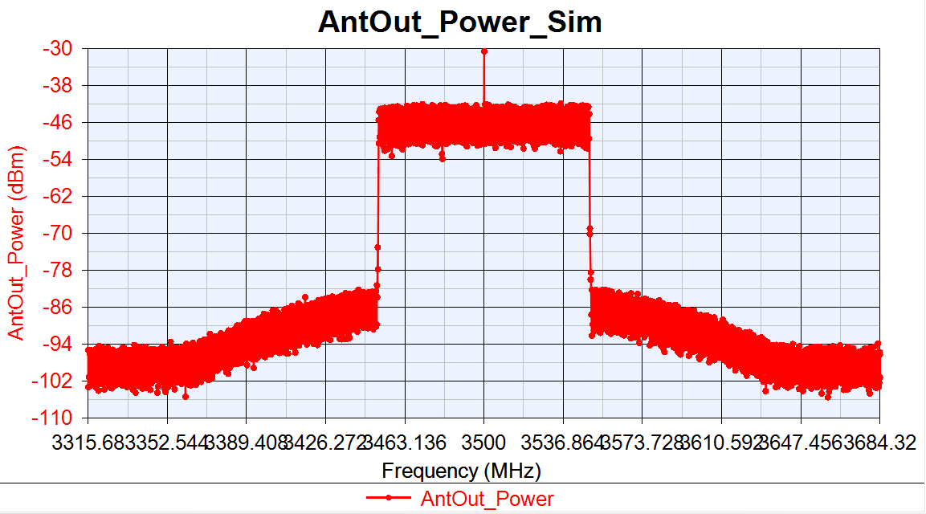

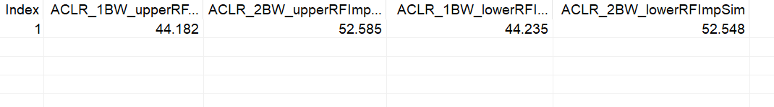
Sim_DAC_Nbits=10

Slide 28


Slide 29
Gain Imblance Test
Gain Imblance Change 10dB:
DAC_Nbits=14
GainImblance=0.02
IQ offset=0.0044
Phase Noise =[100, -97.133, 1000, -106.072, 1e5, -118.607]; PA_TOIout=20
Gain Imblance Change 10dB:
DAC_Nbits=14
GainImblance=0.1
IQ offset=0.0044
Phase Noise =[100, -97.133, 1000, -106.072, 1e5, -118.607]; PA_TOIout=20

Slide 30

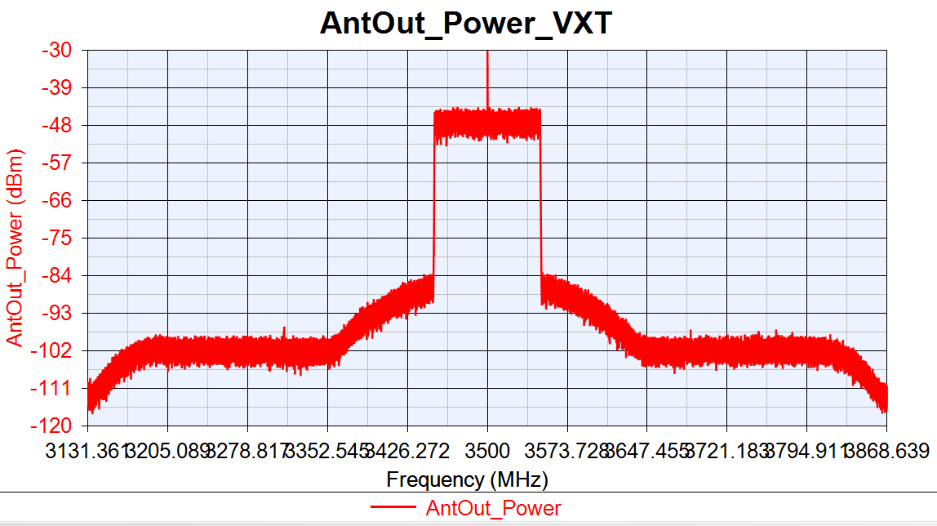


VXT_GainImblance=0.02

Slide 31




Sim_GainImblance=0.02

Slide 32


Slide 33




VXT_GainImblance=0.1

Slide 34




Sim_GainImblance=0.1

Slide 35


Slide 36
IQoffset Test
IQ offset Change 10dB:
DAC_Nbits=14
GainImblance=0.002
IQ offset=0.014
Phase Noise =[100, -97.133, 1000, -106.072, 1e5, -118.607]; PA_TOIout=20
IQ offset Change 15dB:
DAC_Nbits=14
GainImblance=0.002
IQ offset=0.025
Phase Noise =[100, -97.133, 1000, -106.072, 1e5, -118.607]; PA_TOIout=20

Slide 37




VXT_IQoffset=0.014

Slide 38




Sim_IQoffset= 0.014

Slide 39


Slide 40




VXT_IQoffset=0.025

Slide 41




Sim_IQoffset=0.025

Slide 42


Slide 43
Combine Test
Orgin Para:
DAC_Nbits=14
GainImblance=0.002
IQ offset=0.0044
Phase Noise=[100 ]
PA_TOIout=30
Change 5dB:
DAC_Nbits=12
GainImblance=0.01
IQ offset=0.0079
Phase Noise=[100 ]
PA_TOIout=25
Change 10dB:
DAC_Nbits=10
GainImblance=0.02
IQ offset=0.014
Phase Noise=[100 ]
PA_TOIout=20

Slide 44




VXT Org

Slide 45




Sim Org

Slide 46


Slide 47




VXT Change 5dB

Slide 48




Sim Change 5dB

Slide 49


Slide 50




VXT Change 10dB

Slide 51




Sim Change 10dB

Slide 52


